Slide 1

Fundamental Of Structured Programming
Lecture 8
By
Dr. Ahmed Yousry
Lecturer, Computer Science Department,
Faculty of computers and artificial intelligence, benha university

Slide 2


Slide 3
Exercise
How many exclamation marks does the next program part write
for (i=2; i<5; i--) cout << "!";
None
One.
Infinitely many
What is the output of the following code : int main()
{ int num = 9; if (num<0);
num= -num ;
cout<< num; return 0 ; }
  9
  0
  -9
  Syntax error

Slide 4


Exercise (Find the output )
1) x = 2;
y = 4;
cout << x++ << --y;
2) int count = 0, number = 0, limit = 4;
do
{ number += 2;
count++; }
while (count < limit);
cout << number << " " << count << endl;

Slide 5





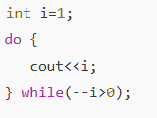

Find the output

Slide 6
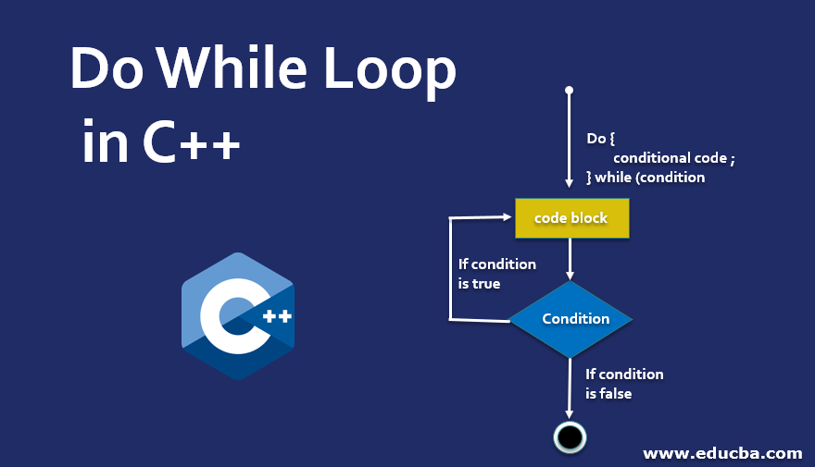

Slide 7
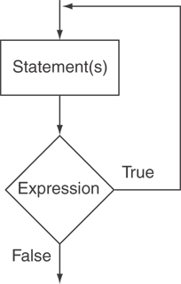
The do-while Loop
do-while: a post-test loop – execute the loop, then test the expression.
General Format:
  do
  statement;// or block in{ }
  while (expression);
Note that: a semicolon is required
after do while(expression)

Slide 8
do-while Loop Notes
Loop always executes at least once
Execution continues as long as condition is true; the loop is exited when condition becomes false
{ } are required, even if the body contains a single statement
; after (condition) is also required
Notes:
See pr5-08.cpp

Slide 9
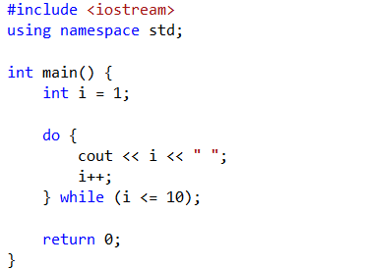

Example: Program that prints the numbers from 1 to 10 using a do-while loop:

Slide 10
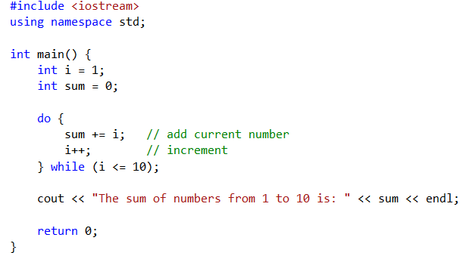

Example: sum number from 1 to 10

Slide 11
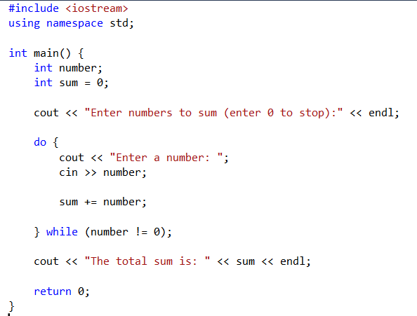
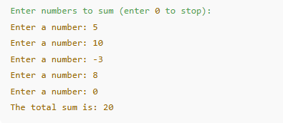
Example:
a do-while loop in C++ that calculates the sum of user-entered numbers until the user enters 0 to stop:

Slide 12
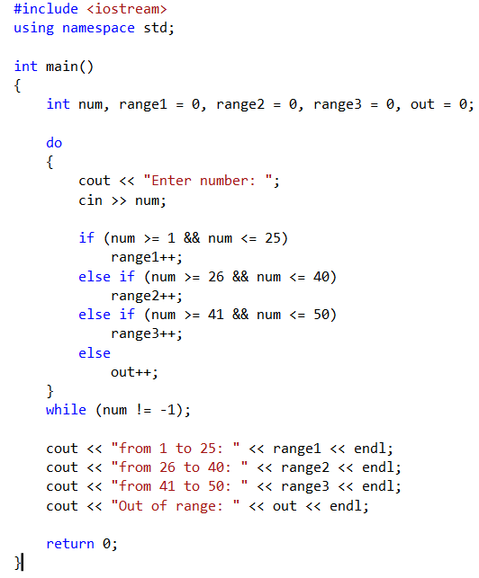
Example
Enter number: 5
Enter number: 6
Enter number: 8
Enter number: 45
Enter number: -1
from 1 to 25: 3
from 26 to 40: 0
from 41 to 50: 1
Out of range: 1

Slide 13
Menu-Driven Program Example
do {
// code to display menu
// and perform actions
cout << "Another choice? (Y/N) ";
} while (choice =='Y'||choice =='y');
The condition could be written as
(toupper(choice) == 'Y');
or as
(tolower(choice) == 'y');
Notes:
See pr5-09.cpp

Slide 14
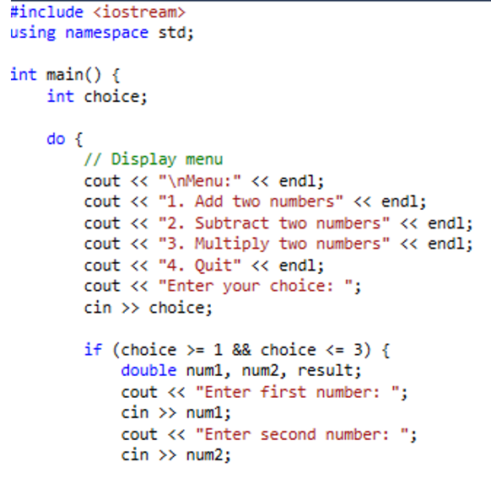
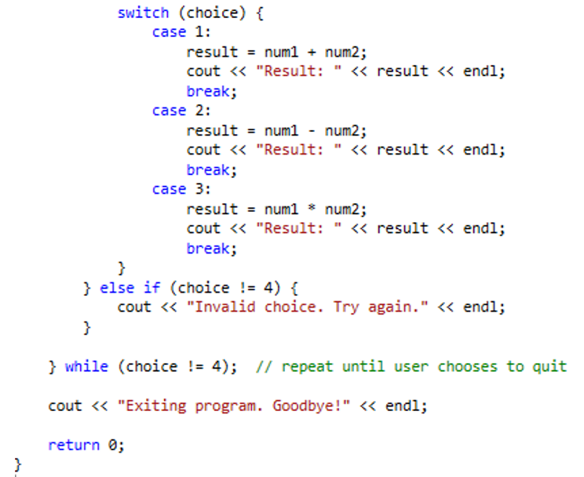
Example

Slide 15
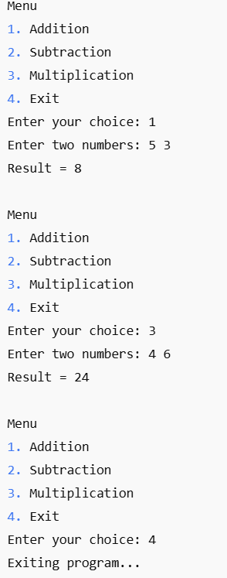
Output

Slide 16
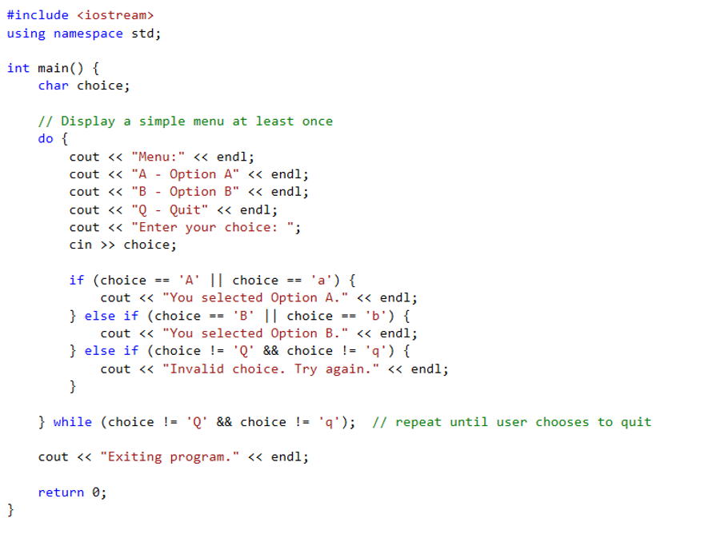
Example

Slide 17
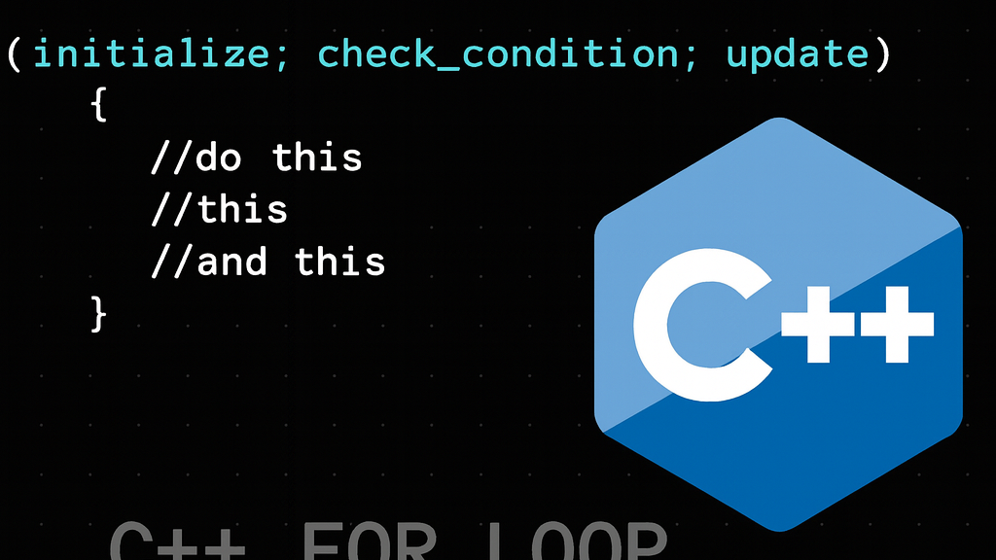

Slide 18
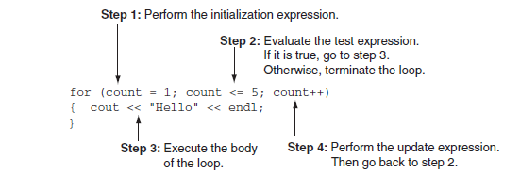
The for Loop
Useful for counter-controlled loop.
General Format:
  for(initialization; test; update)
  statement; // or block in { }
No semicolon after 3rd expression or after the ”)”.

Slide 19
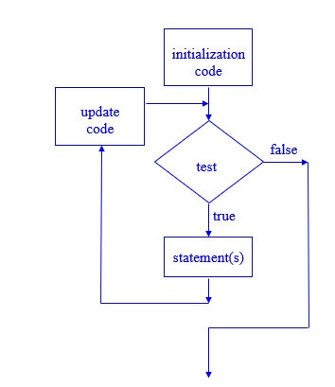
for Loop - Mechanics
for(initialization; test; update)
  statement; // or block in { }
Perform initialization.
Evaluate test expression :
  If true, execute statement
  If false, terminate loop execution
Execute update, then re-evaluate test expression.

Slide 20
for Loop Example
int sum = 0, num;
for (num = 1; num <= 10; num++)
  sum += num;
cout << "Sum of numbers 1 – 10 is "
  << sum << endl;
Notes:
See pr5-10.cpp

Slide 21
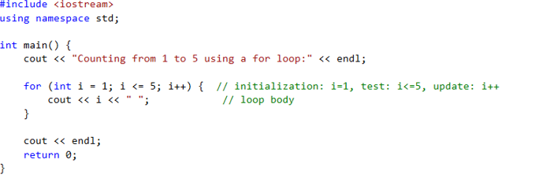
Example: print number
Program Output:
Counting from 1 to 5 using a for loop:
1 2 3 4 5

Slide 22
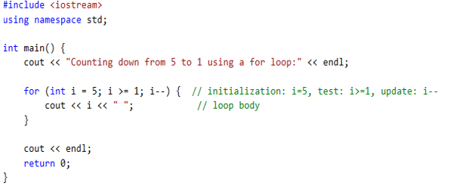
Example
Program Output:
Counting down from 5 to 1 using a for loop:
5 4 3 2 1

Slide 23
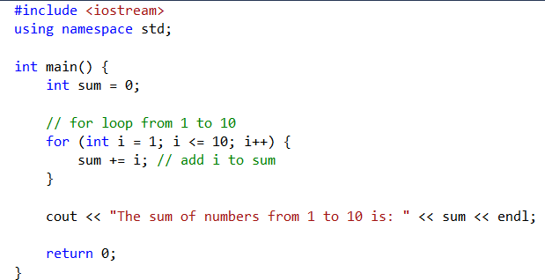

Example: Sum number from 1 to 10

Slide 24
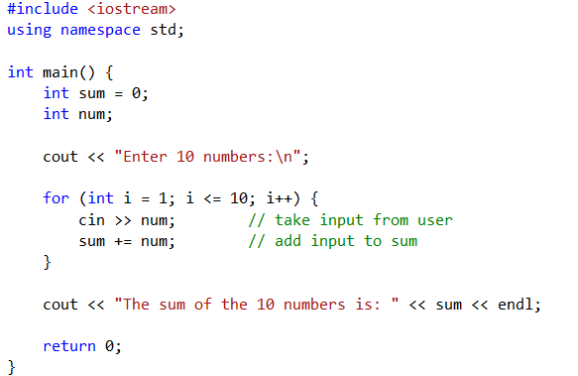
Example: program that calculates the sum of 10 numbers entered by the user
Output
2 5 3 7 1 4 6 8 9 10
The sum of the 10 numbers is: 55

Slide 25
for Loop Modifications
Initialization and update code can contain more than one statement
  Separate the statements with commas
Example:
  for (int sum = 0, num = 1; num <= 10; num++)
  sum += num;
Can omit initialization if already done
int sum = 0, num = 1;
for (; num <= 10; num++)
sum += num;

Slide 26
More for Loop Modifications
Can omit update if done in loop
for (sum = 0, num = 1; num <= 10;)
sum += num++;
Can omit test – may cause an infinite loop
  for (sum = 0, num = 1; ; num++)
  sum += num;

Slide 27
Sentinels
sentinel: value in a list of values that indicates end of the list
Special value that cannot be confused with a valid value, e.g., -999 for a test score
Used to terminate input when user may not know how many values will be entered

Slide 28
Sentinel Example
int total = 0;
cout << "Enter points earned "
<< "(or -1 to quit): ";
cin >> points;
while(points != -1)//-1 is the sentinel
{
total += points;
cout <<"Enter points earned: ";
cin >> points;
}
Notes:
See pr5-12.cpp

Slide 29
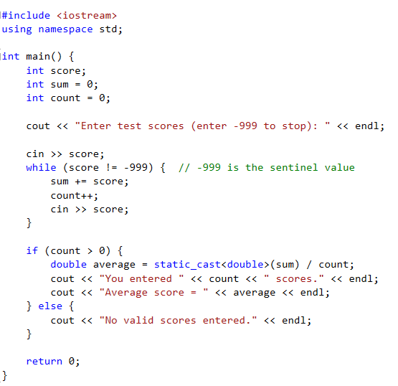
Example

Slide 30
Deciding Which Loop to Use
while: pretest loop (loop body may not be executed at all)
do-while: post test loop (loop body will always be executed at least once)
for: pretest loop (loop body may not be executed at all); has initialization and update code; is useful with counters or if precise number of repetitions is known

Slide 31
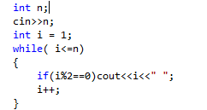
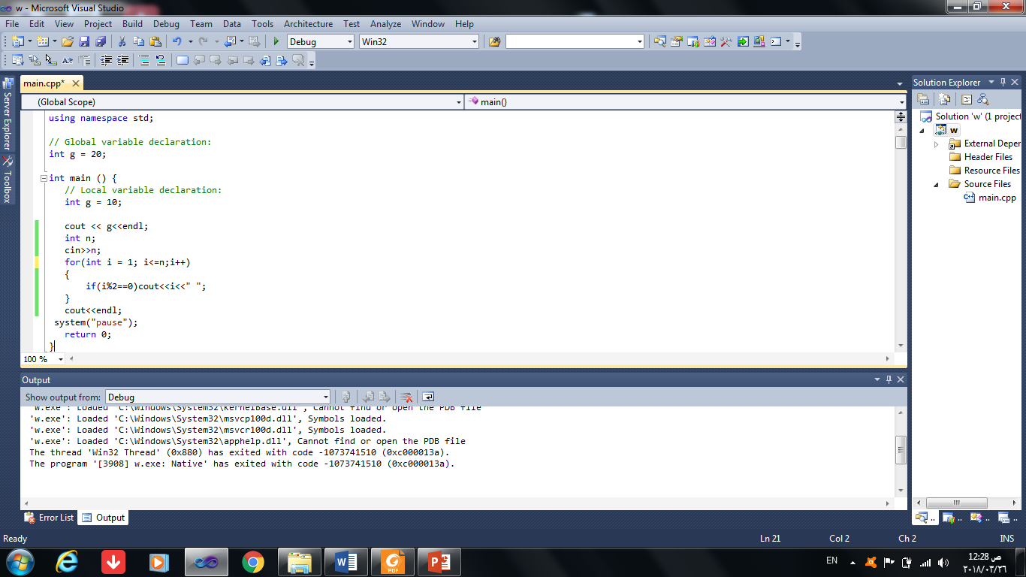
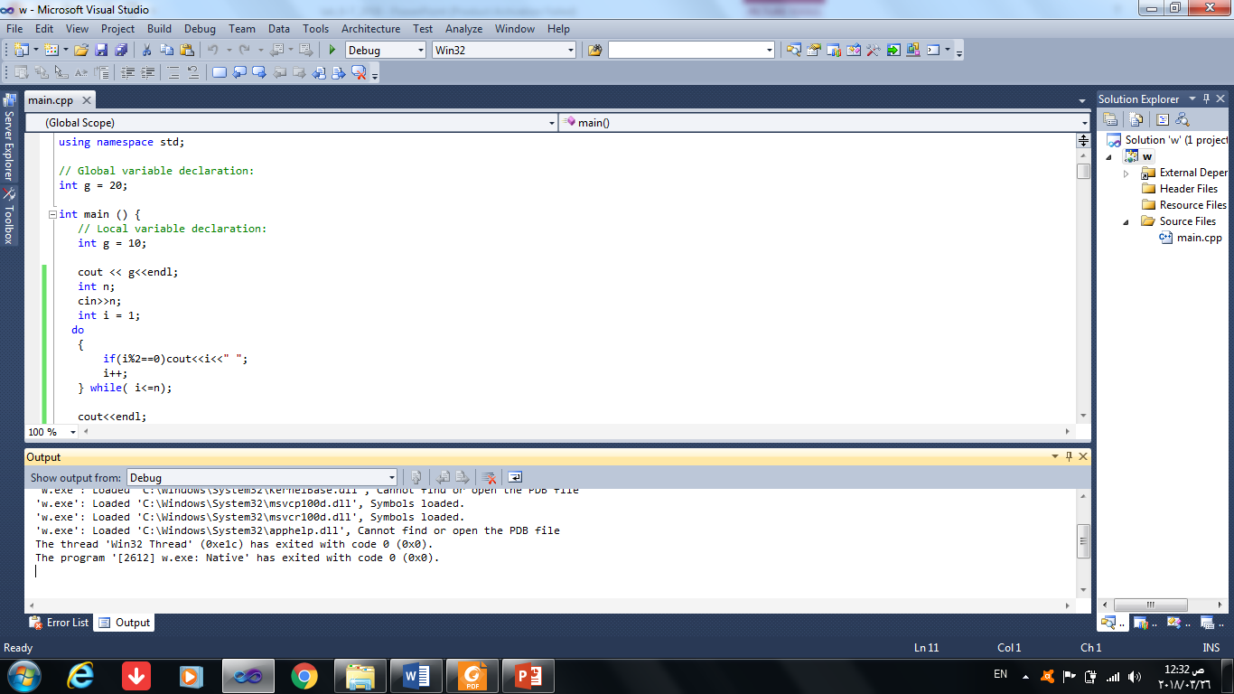
Exercise
Write a C++ program to print all even numbers between 1 to n. - using loop:

Slide 32
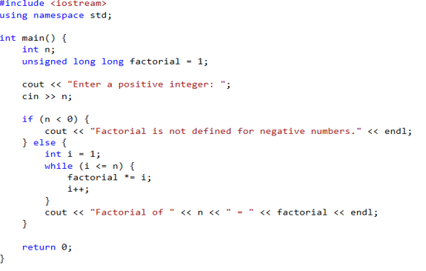
Exercise
Using loops to calculate the factorial of a positive integer entered by the user.

Slide 33
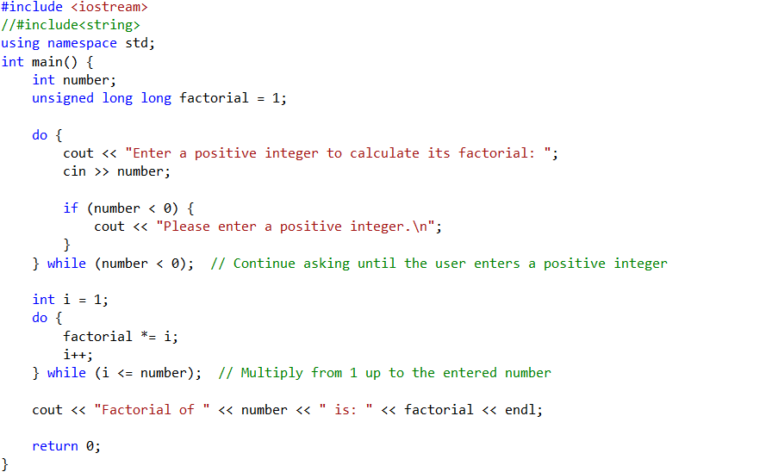
Do-while
Example Runs:
Input: 5
Output: Factorial of 5 = 120
Input: 0
Output: Factorial of 0 = 1

Slide 34
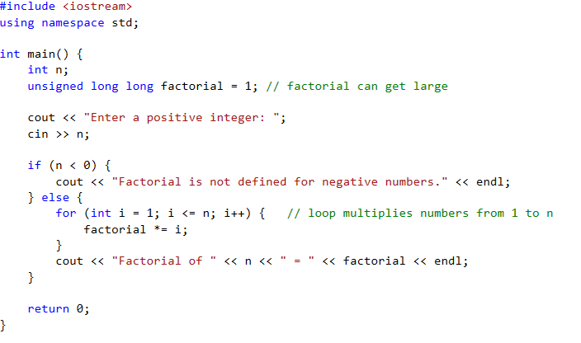
For loop
Example Runs:
Input: 5
Output: Factorial of 5 = 120
Input: 0
Output: Factorial of 0 = 1

Slide 35
Nested Loops
A nested loop is a loop inside the body of another loop
Example:
  for (row = 1; row <= 3; row++)
  {
  for (col = 1; col <= 3; col++)
  {
  cout << row * col << endl;
  }
  }
outer loop
inner loop
Notes:
See pr5-13.cpp

Slide 36
Notes on Nested Loops
Inner loop goes through all its repetitions for each repetition of outer loop
Inner loop repetitions complete sooner than outer loop
Total number of repetitions for inner loop is product of number of repetitions of the two loops. In previous example, inner loop repeats 9 times

Slide 37
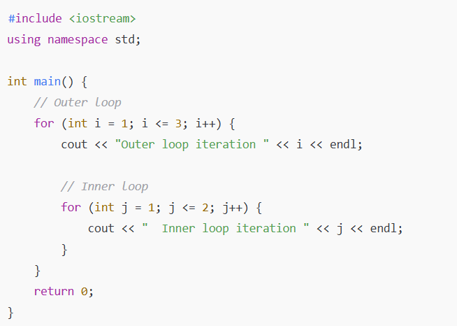
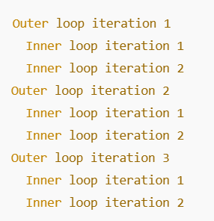
Example

Slide 38
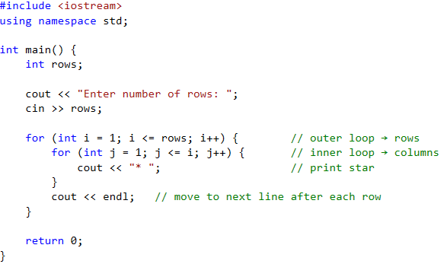
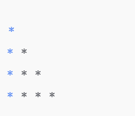
Example

Slide 39
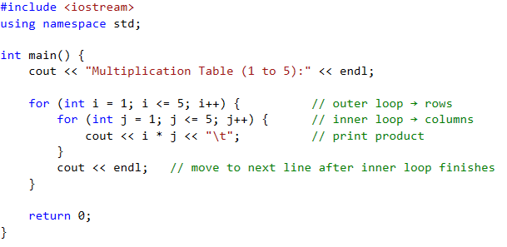
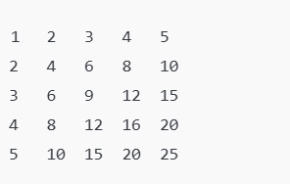
Example

Slide 40
Breaking Out of a Loop
Can use break to terminate execution of a loop
Use sparingly if at all – makes code harder to understand
When used in an inner loop, terminates that loop only and returns to the outer loop
Notes:
See pr5-14.cpp

Slide 41
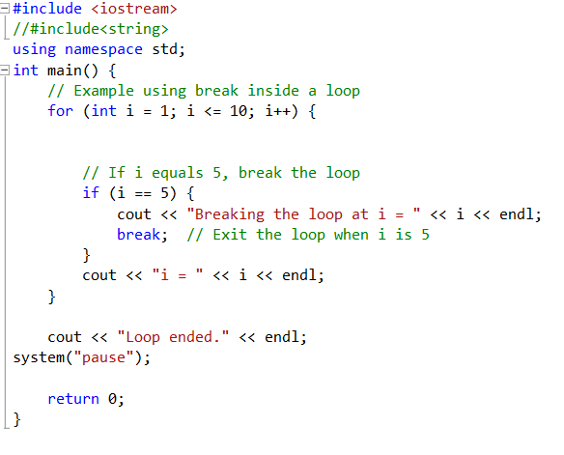
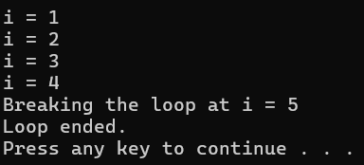
Example

Slide 42
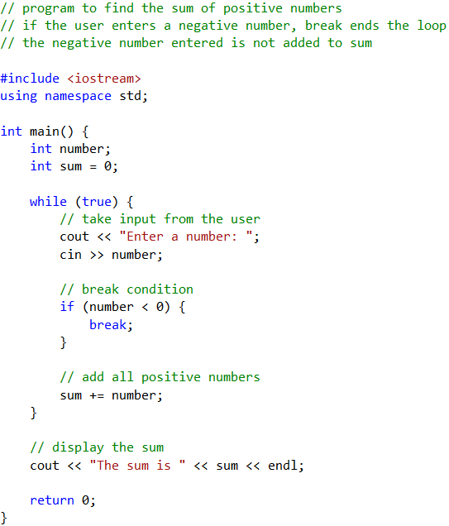
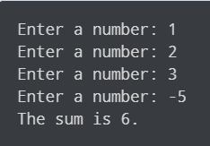
Example

Slide 43
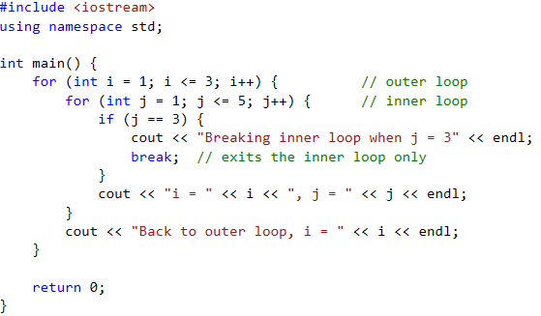
Example
Program Output:
i = 1, j = 1
i = 1, j = 2
Breaking inner loop when j = 3
Back to outer loop, i = 1
i = 2, j = 1
i = 2, j = 2
Breaking inner loop when j = 3
Back to outer loop, i = 2
i = 3, j = 1
i = 3, j = 2
Breaking inner loop when j = 3
Back to outer loop, i = 3

Slide 44
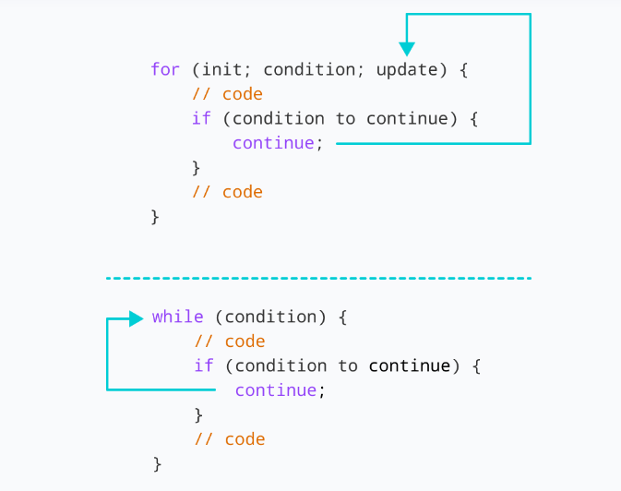
The continue Statement
Can use continue to go to end of loop and prepare for next repetition
  while and do-while loops go to test and repeat the loop if test condition is true
  for loop goes to update step, then tests, and repeats loop if test condition is true
Use sparingly – like break, can make
program logic hard to follow
Notes:
See pr5-15.cpp

Slide 45
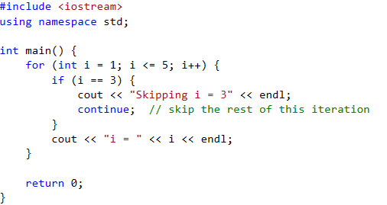
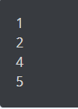
Example using for loop
Program Output:
i = 1
i = 2
Skipping i = 3
i = 4
i = 5

Slide 46
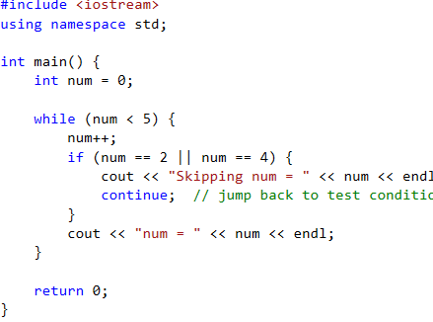
Example
Program Output:
num = 1
Skipping num = 2
num = 3
Skipping num = 4
num = 5

Slide 47
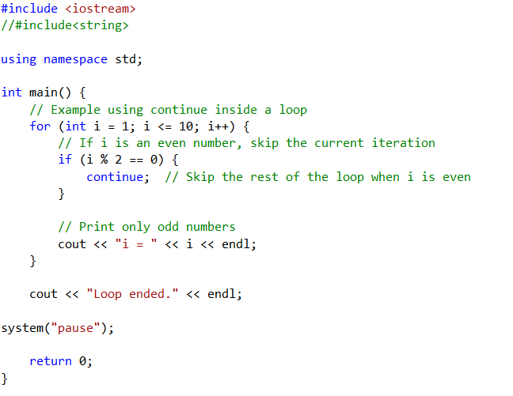
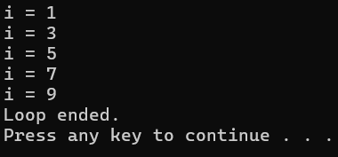
Example

Slide 48
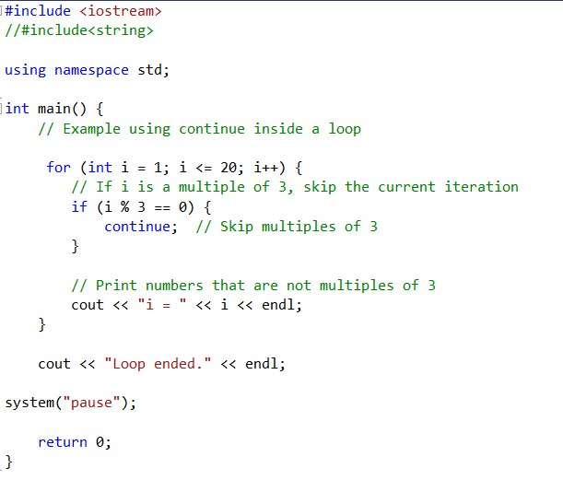
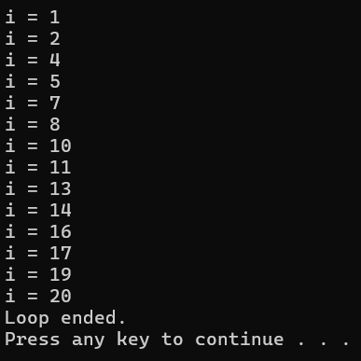
Example

Slide 49
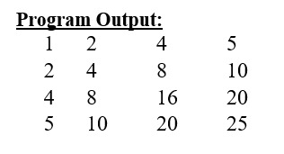
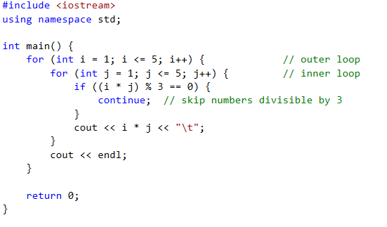
Example

Slide 50
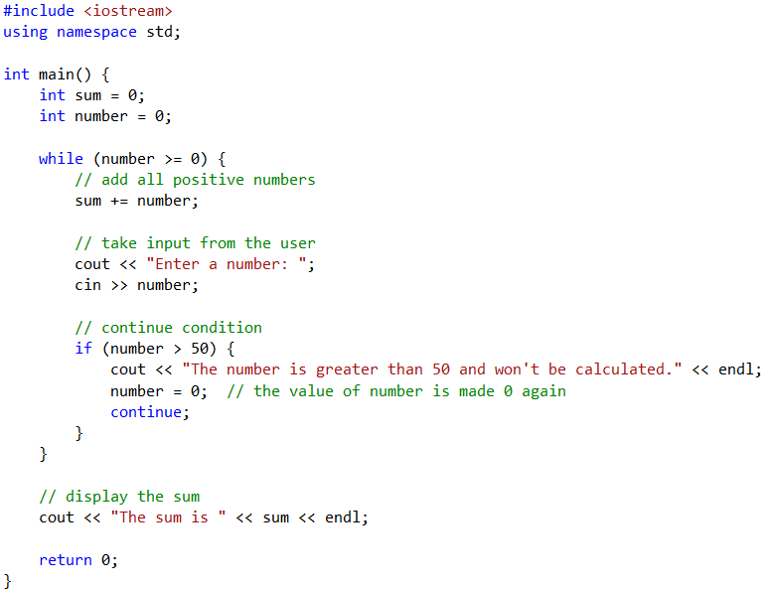
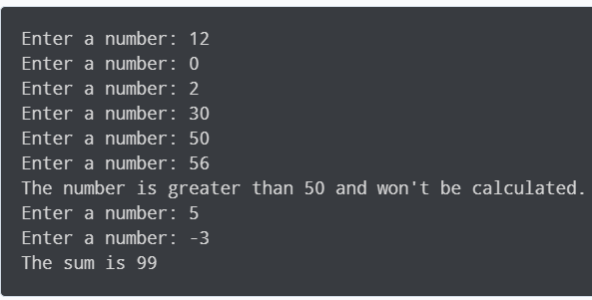
Example using while loop

Slide 51
Example
Identify the problem in the following program. What happens if you compile and execute the program?
        int main()
        {
        int i;
        for (i = 5; i > 0; i--)
        i++;
        return 0;
        }

Slide 52
More Mathematical Library Functions
Require cmath header file
Take double as input, return a double
Commonly used functions:
sin | Sine
cos | Cosine
tan | Tangent
sqrt | Square root
log | Natural (e) log
abs | Absolute value (takes and returns an int)

Slide 53
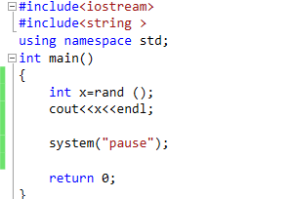

More Mathematical Library Functions
rand(): returns a random number (int) between 0 and the largest int (32767 ) the compute holds. Yields same sequence of numbers each time program is run.

Slide 54



More on Random Numbers
These require cstdlib header file
srand(x): initializes random number generator with unsigned int x
Notes:
See pr3-34.cpp

Slide 55



Rand () function
Use time() to generate different seed values each time that a program runs:
      #include <ctime> //needed for time()
      …
      unsigned seed = time(0);
      srand(seed);

Slide 56




Rand() function
Random numbers can be scaled to a range:
    int max=6;
    int num;
    num = rand() % max + 1;

Slide 57
Basic Types of Programming Errors
Syntax Errors
  Syntax errors mean that they don’t follow a correct sequence in the computer language.
Runtime Errors
  Runtime errors in a program are the errors that occur while the program is running after
being successfully compiled.
Logical Errors
  Logical errors are the hardest of all error types to detect. They do not cause the program to
  crash or simply not work at all, they cause it to “misbehave” in some way.

Slide 58




Example (syntax error)

Slide 59


example(Runtime Errors)

Slide 60




Example (Logical Errors)

Slide 61
Thank you

